Slide 1
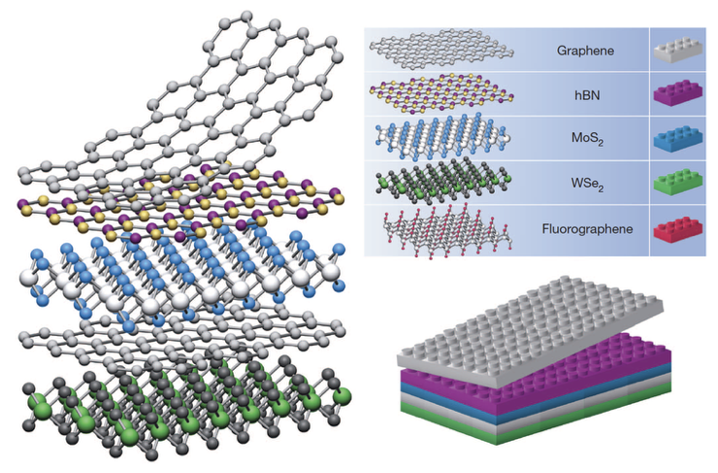
A Transition Metal Dichalcogenide Interlayer Coupling Database
S. Fang, S. Torrisi, E. Muramoto, T. Zhao

Slide 2
Overview
PROBLEM: Modeling TMDC’s from a big-compute and big-data perspective
Big Compute: Material ➤ Density Functional Theory ➤ Wannier Function Generation
Big Data: Orbital indices ➤ Database ➤ coupling ➤ TBH

Slide 3
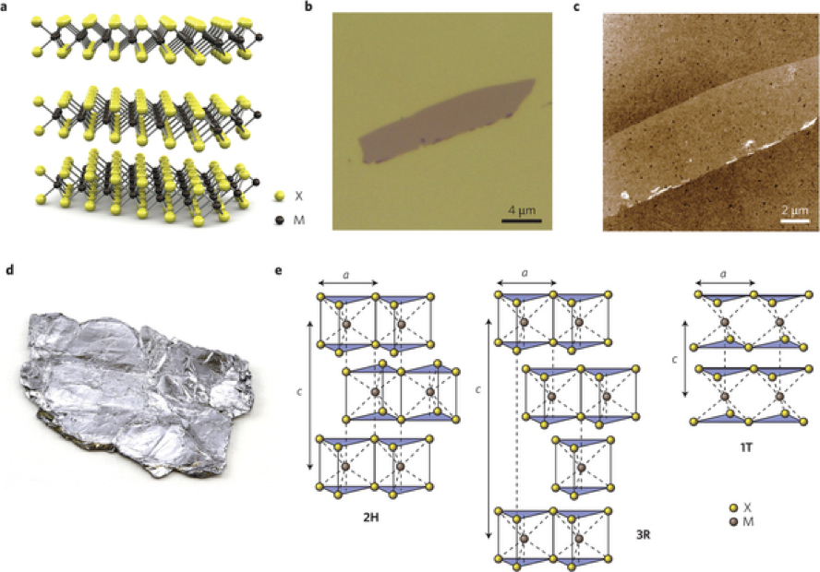
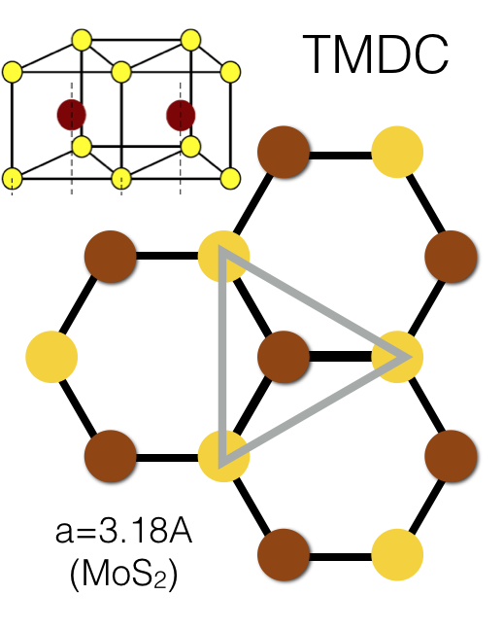
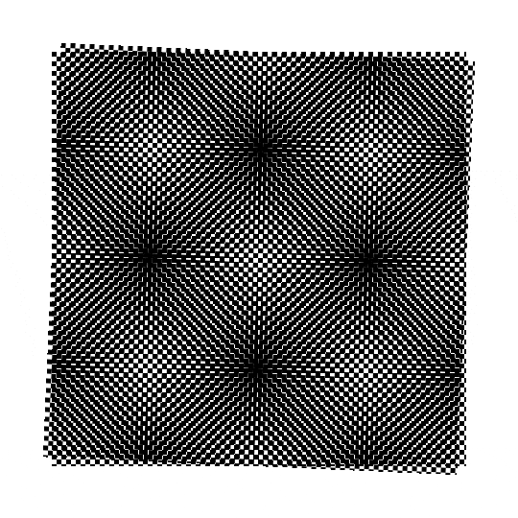
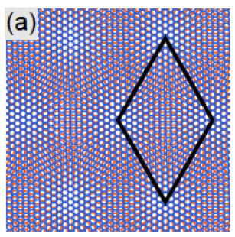
Challenges for Numerical Simulations
Goal: vdW heterostructure design / performance optimization

Slide 4
Orbital-Orbital Interactions: Wannier Functions
Obtain orbitals for each atom,
coupling between individual
orbitals on each layer
4x Chalcogen (Sulfur): 3X p
Unit Cell
(6 atoms)
2xTransition Metal (Molybdenum): 5X d
=22 Orbitals (11 per layer)

Slide 5
Overview
PROBLEM: Modeling TMDC’s from a big-compute and big-data perspective
Big Compute: Material ➤ Density Functional Theory ➤ Wannier Function Generation
Big Data: Orbital indices ➤ Database ➤ coupling ➤ TBH

Slide 6
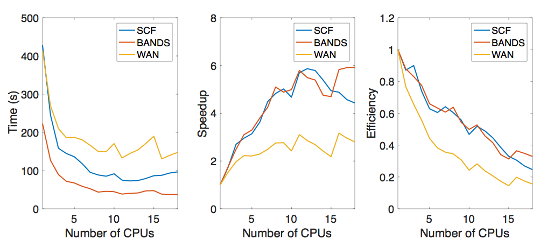
Material Simulation: Density Functional Theory (DFT) + Wannier Transformation
VASP: Vienna Ab initio Simulation Package
Self-Consistent Calculation
VASP
non Self-Consistent Run for Wannier
VASP then Wannier90

Slide 7
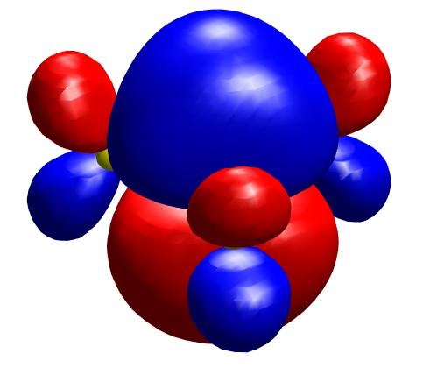
Simulation Data Post-Processing
Information from DFT/VASP and Wannier90
Goal: post-process and clean up the data, and apply appropriate transformation to the raw data to turn them into physically transparent quantities.
POSCAR
wannier90.win
wannier90.r2mn
wannier90_centres.xyz
wannier90_hr.dat
# header
atom_from_type,atom_from_orbital,atom_from_index,atom_to_type,atom_to_orbital,atom_to_index,hop_vec_x,hop_vec_y,hop_vec_z,ham_real,ham_imag,a1_x,a1_y,a2_x,a2_y,layer_h
Ta,dz2,1,Ta,dz2,1,14.350000000000001,-28.169,0.0,-1.2e-05,0.0,2.87,-1.657,2.87,1.657,5.988
Ta,dz2,1,Ta,dxz,2,14.350000000000001,-28.169,0.0,1.5e-05,-0.0,2.87,-1.657,2.87,1.657,5.988
Ta,dz2,1,Ta,dyz,3,14.350000000000001,-28.169,0.0,-0.0,-0.0,2.87,-1.657,2.87,1.657,5.988
Ta,dz2,1,Ta,dx2y2,4,14.350000000000001,-28.169,0.0,6.5e-06,0.0,2.87,-1.657,2.87,1.657,5.988
Ta,dz2,1,Ta,dxy,5,14.350000000000001,-28.169,0.0,0.0,0.0,2.87,-1.657,2.87,1.657,5.988
Ta,dz2,1,Ta,dz2,6,14.350000000000001,-28.169,5.988,3.5e-06,0.0,2.87,-1.657,2.87,1.657,5.988
Ta,dz2,1,Ta,dxz,7,14.350000000000001,-28.169,5.988,-1.45e-05,-0.0,2.87,-1.657,2.87,1.657,5.988
Ta,dz2,1,Ta,dyz,8,14.350000000000001,-28.169,5.988,0.0,-0.0,2.87,-1.657,2.87,1.657,5.988

Slide 8
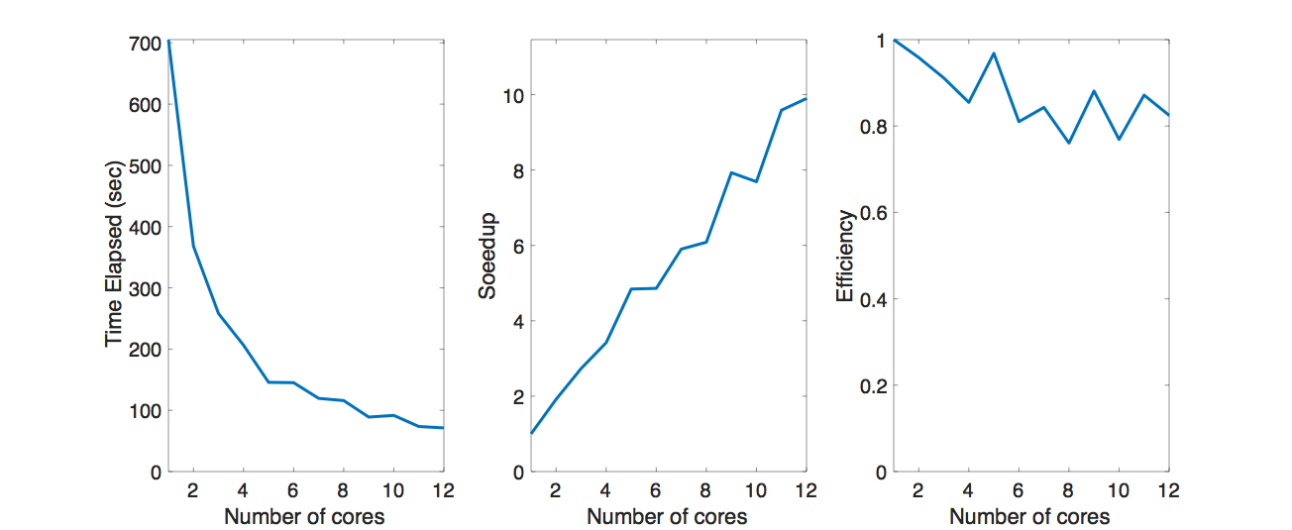
Simulation Data Post-Processing:
Parallelization
Multiprocessing tool from python

Slide 9
Overview
PROBLEM: Modeling TMDC’s from a big-compute and big-data perspective
Big Compute: Material ➤ Density Functional Theory ➤ Wannier Function Generation
Big Data: Orbital indices ➤ Database ➤ coupling ➤ TBH

Slide 10
Bottleneck when Building TBH: Query
What we want to do with the data:
Build TBH matrix using 400 files
Query the database ~300 times
“Query”
Keys
Atom pair
“atom_from_index”
“atom_to_index”
Database with cleaned up data
Values
Displacements
'hop_vec_x’
'hop_vec_y’
'hop_vec_z’
Coupling
'ham_real'
# header
atom_from_type,atom_from_orbital,atom_from_index,atom_to_type,atom_to_orbital,atom_to_index,hop_vec_x,hop_vec_y,hop_vec_z,ham_real,ham_imag,a1_x,a1_y,a2_x,a2_y,layer_h
Ta,dz2,1,Ta,dz2,1,14.350000000000001,-28.169,0.0,-1.2e-05,0.0,2.87,-1.657,2.87,1.657,5.988
Ta,dz2,1,Ta,dxz,2,14.350000000000001,-28.169,0.0,1.5e-05,-0.0,2.87,-1.657,2.87,1.657,5.988
Ta,dz2,1,Ta,dyz,3,14.350000000000001,-28.169,0.0,-0.0,-0.0,2.87,-1.657,2.87,1.657,5.988
Ta,dz2,1,Ta,dx2y2,4,14.350000000000001,-28.169,0.0,6.5e-06,0.0,2.87,-1.657,2.87,1.657,5.988
Ta,dz2,1,Ta,dxy,5,14.350000000000001,-28.169,0.0,0.0,0.0,2.87,-1.657,2.87,1.657,5.988
Ta,dz2,1,Ta,dz2,6,14.350000000000001,-28.169,5.988,3.5e-06,0.0,2.87,-1.657,2.87,1.657,5.988
Ta,dz2,1,Ta,dxz,7,14.350000000000001,-28.169,5.988,-1.45e-05,-0.0,2.87,-1.657,2.87,1.657,5.988
Ta,dz2,1,Ta,dyz,8,14.350000000000001,-28.169,5.988,0.0,-0.0,2.87,-1.657,2.87,1.657,5.988
# header
atom_from_type,atom_from_orbital,atom_from_index,atom_to_type,atom_to_orbital,atom_to_index,hop_vec_x,hop_vec_y,hop_vec_z,ham_real,ham_imag,a1_x,a1_y,a2_x,a2_y,layer_h
Ta,dz2,1,Ta,dz2,1,14.350000000000001,-28.169,0.0,-1.2e-05,0.0,2.87,-1.657,2.87,1.657,5.988
Ta,dz2,1,Ta,dxz,2,14.350000000000001,-28.169,0.0,1.5e-05,-0.0,2.87,-1.657,2.87,1.657,5.988
Ta,dz2,1,Ta,dyz,3,14.350000000000001,-28.169,0.0,-0.0,-0.0,2.87,-1.657,2.87,1.657,5.988
Ta,dz2,1,Ta,dx2y2,4,14.350000000000001,-28.169,0.0,6.5e-06,0.0,2.87,-1.657,2.87,1.657,5.988
Ta,dz2,1,Ta,dxy,5,14.350000000000001,-28.169,0.0,0.0,0.0,2.87,-1.657,2.87,1.657,5.988
Ta,dz2,1,Ta,dz2,6,14.350000000000001,-28.169,5.988,3.5e-06,0.0,2.87,-1.657,2.87,1.657,5.988
Ta,dz2,1,Ta,dxz,7,14.350000000000001,-28.169,5.988,-1.45e-05,-0.0,2.87,-1.657,2.87,1.657,5.988
Ta,dz2,1,Ta,dyz,8,14.350000000000001,-28.169,5.988,0.0,-0.0,2.87,-1.657,2.87,1.657,5.988
# header
atom_from_type,atom_from_orbital,atom_from_index,atom_to_type,atom_to_orbital,atom_to_index,hop_vec_x,hop_vec_y,hop_vec_z,ham_real,ham_imag,a1_x,a1_y,a2_x,a2_y,layer_h
Ta,dz2,1,Ta,dz2,1,14.350000000000001,-28.169,0.0,-1.2e-05,0.0,2.87,-1.657,2.87,1.657,5.988
Ta,dz2,1,Ta,dxz,2,14.350000000000001,-28.169,0.0,1.5e-05,-0.0,2.87,-1.657,2.87,1.657,5.988
Ta,dz2,1,Ta,dyz,3,14.350000000000001,-28.169,0.0,-0.0,-0.0,2.87,-1.657,2.87,1.657,5.988
Ta,dz2,1,Ta,dx2y2,4,14.350000000000001,-28.169,0.0,6.5e-06,0.0,2.87,-1.657,2.87,1.657,5.988
Ta,dz2,1,Ta,dxy,5,14.350000000000001,-28.169,0.0,0.0,0.0,2.87,-1.657,2.87,1.657,5.988
Ta,dz2,1,Ta,dz2,6,14.350000000000001,-28.169,5.988,3.5e-06,0.0,2.87,-1.657,2.87,1.657,5.988
Ta,dz2,1,Ta,dxz,7,14.350000000000001,-28.169,5.988,-1.45e-05,-0.0,2.87,-1.657,2.87,1.657,5.988
Ta,dz2,1,Ta,dyz,8,14.350000000000001,-28.169,5.988,0.0,-0.0,2.87,-1.657,2.87,1.657,5.988
400 files

Slide 11
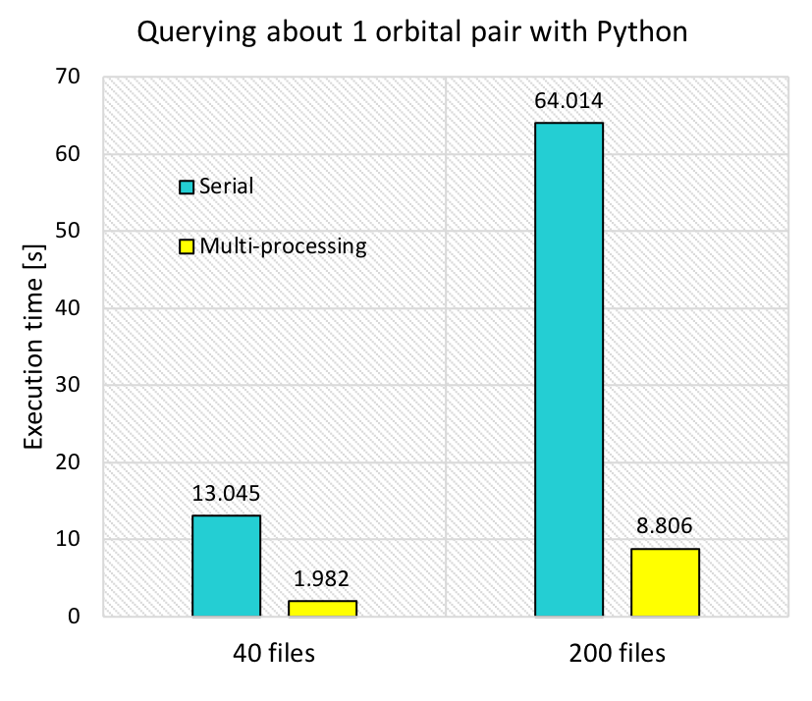
Serial Query with Standard Python
Serial query on AWS instance
Multiprocessing with Python
* AWS 1 m4.4xlarge instance
def load_orbitals_python(f,k,l,debug=False):
with open(f,'r') as f_:
thelines=f_.readlines()[1:]
…
hits = [line.strip().split(',') for line in thelines if ( (int(line.split(',')[2])==k and line.split(',')[5]==l) or (int(line.split(',')[2])==l and int(line.split(',')[5])==k)) ]
if debug:
print("Found %d hits" % len(hits))
return [[float(hit[n]) for n in [6,7,8,9]] for hit in hits]
Serial query took 13 s for 40 files, and multiprocessing improved it to 2 s
Still slow since we query ~300 times

Slide 12
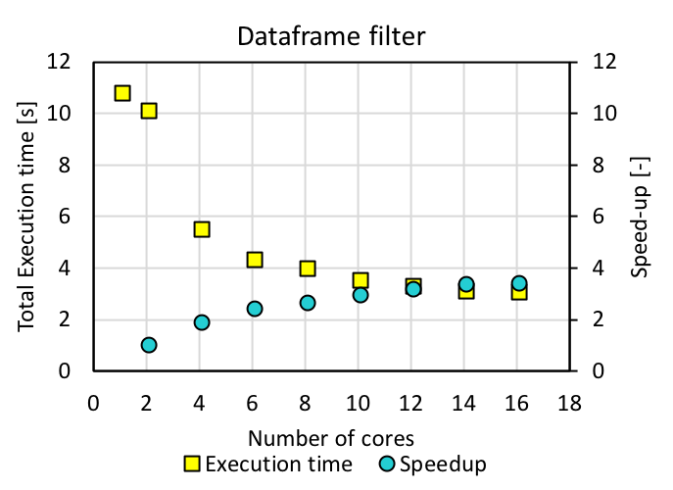
Query with Spark
Dataframe.filter()
df = spark.read.format("csv").option("header", "true").load(files)
df = df.select(‘atom_from_index’,‘atom_to_index’,‘hop_vec_x’,‘hop_vec_y’, ‘hop_vec_z’, ‘ham_real’)
.repartition('atom_from_index', 'atom_to_index’)
df2 = df.filter((df.atom_from_index == '11') & (df.atom_to_index == '11'))
df2_np = np.array(df2.select('hop_vec_x','hop_vec_y','hop_vec_z','ham_real').collect())
Spark cluster on AWS
3 m4.2xlarge instances (8 vCPU)
Not much improvement after 10 cores
3 m4.4xlarge instances (16 vCPU) (1 master, 2 workers)
Not much different from multiprocessing

Slide 13
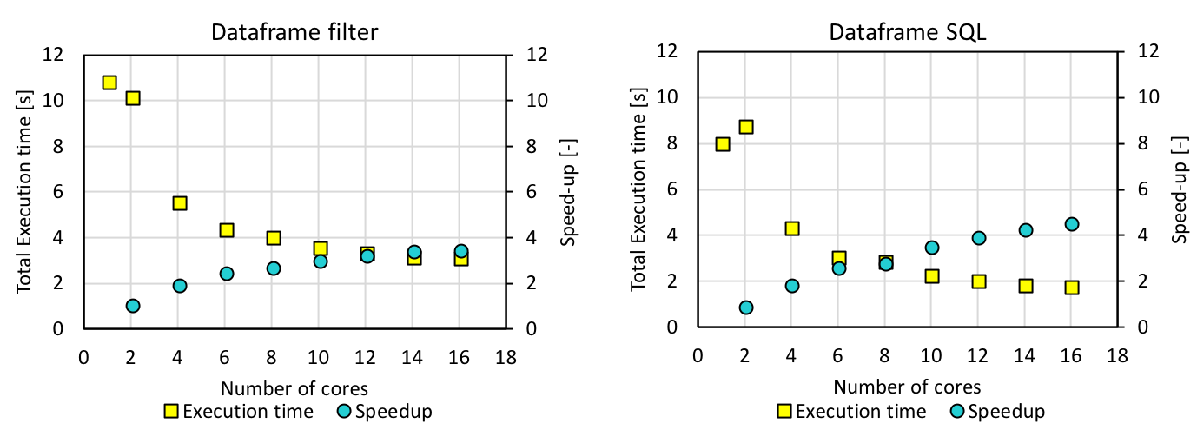
Advanced Spark features: Spark SQL
Spark SQL: Spark module for structured data processing
df.registerTempTable("Temp")
spark.sql(“SELECT hop_vec_x, hop_vec_y, hop_vec_z, ham_real FROM Temp WHERE atom_from_index = '11' AND atom_to_index = '11'")
Spark SQL on a dataframe: a little faster but still not good enough

Slide 14
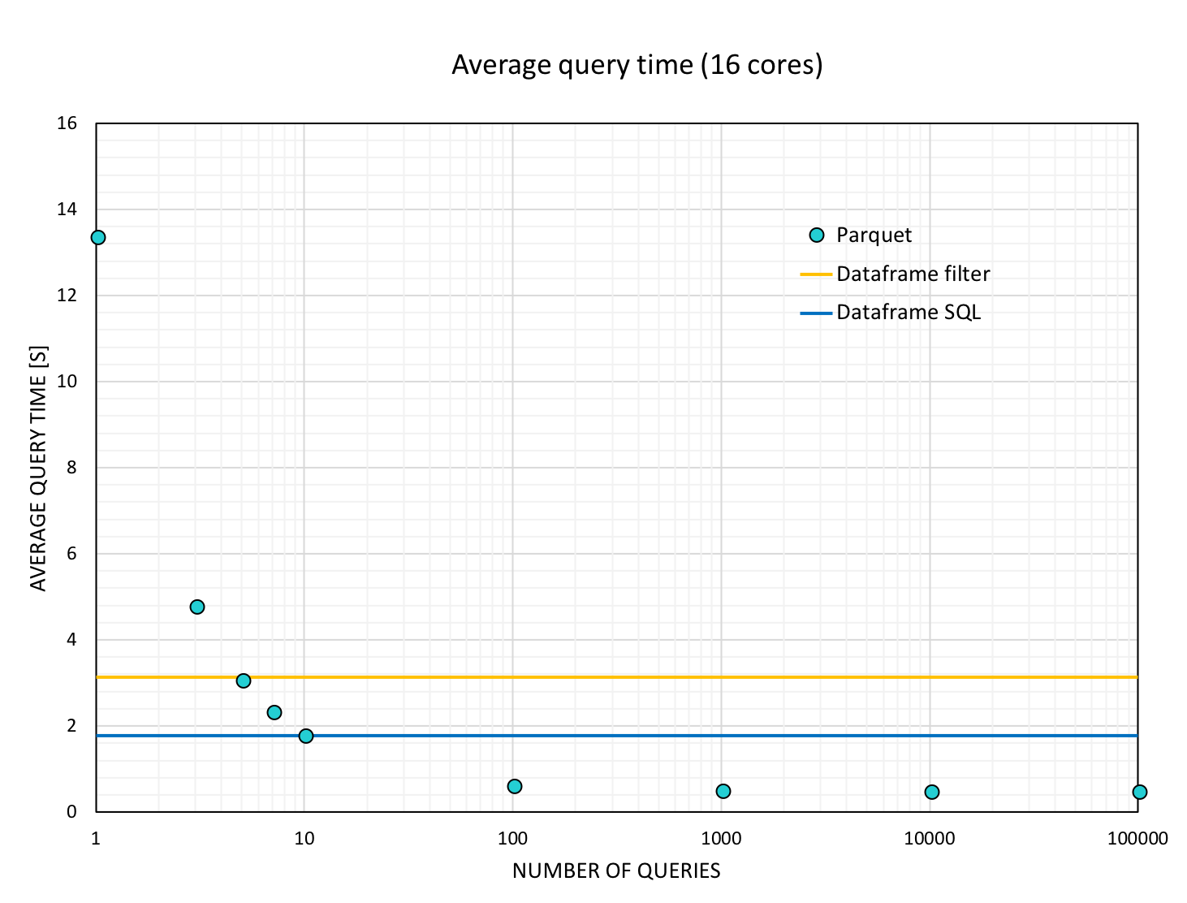
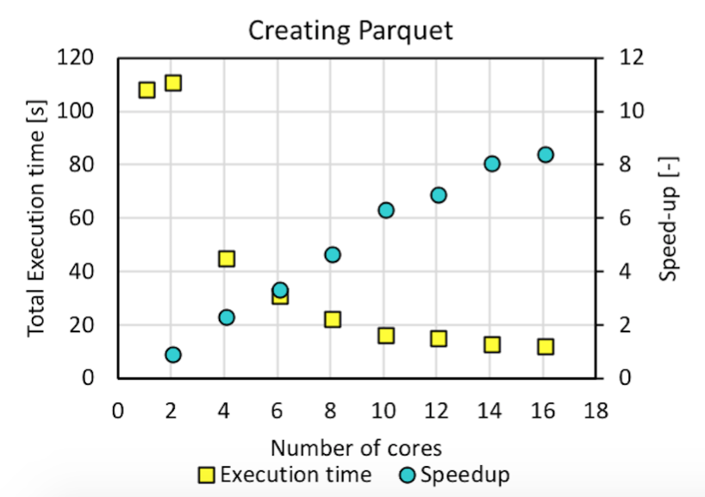
Further Improvement for Spark SQL
Run Spark SQL on a better partitioned data structure
df.write.partitionBy(‘orbital from’, ‘orbital to’).format(parquet).save(‘path to table’)
path
to
table
orbital from = 1
…
orbital to = 2
…
orbital from = 21
…
orbital to = 22
For each query: 2s → 0.4s (for 40 datafiles)
Average query time comparison
Notes:
We tried df.repartition before Although we are “introducing” some overheads, it’s actually getting better when looking at average query time comparison

Slide 15
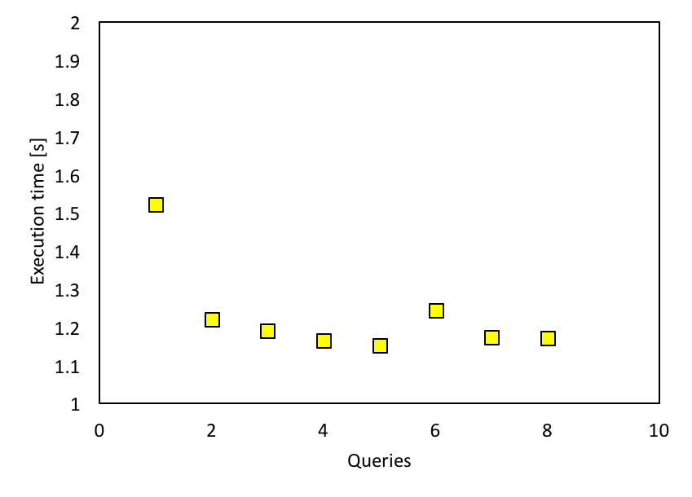
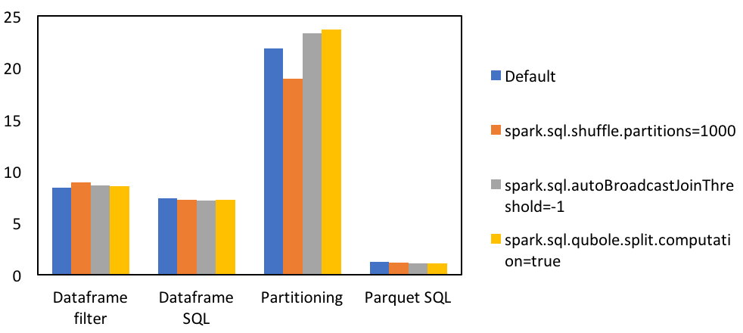
Performance Tuning
Caching Data In Memory
The whole dataframe is too big to cache
Spark SQL caches Parquet data for better performance
Other Configuration Options

Slide 16
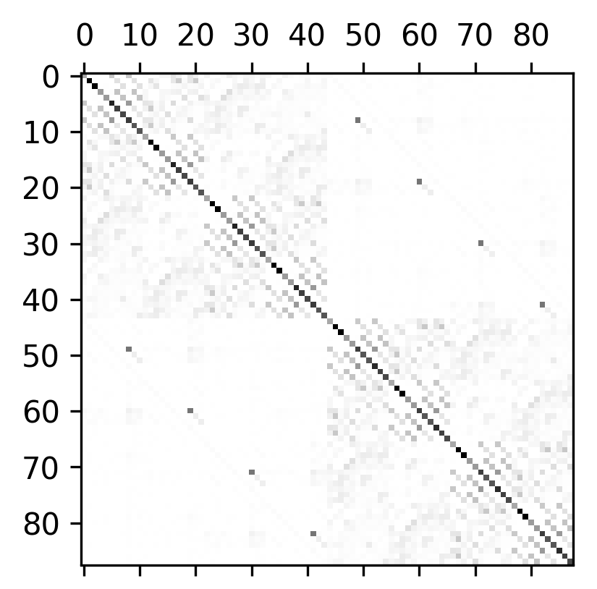
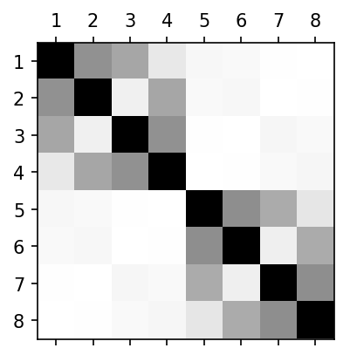
Tight Binding Hamiltonian Visualized
(For 8 ‘Atoms’)

Slide 17

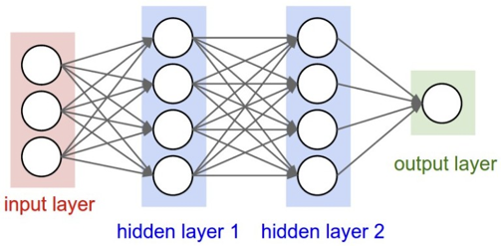
Outlook: Analysis and Learning
Big database for various:
Atomic species
Orbitals types
Symmetry and geometry
Bonding vectors
CDW deformations / strains / pressure on crystals / relaxations
Phases (magnetic, topological, etc.)
Substrates
Learning targets
Coupling strength
Intralayer corrections

Slide 18
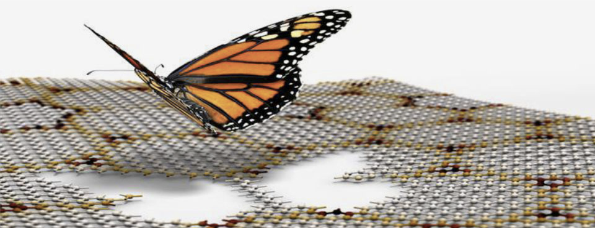
Questions?

